Slide 1
Let there be light new progress in photostimulation apparatus
Group Member：
1-Theory 陈佳琦 生医5 2015080116
2-Optrode 陈佳琦 生医6 2016013210
3-Application 王菲 生医6 2016013197
4-Vision 南志睿 生医5 2015080115

Slide 2
1 Theory
Introductions of Optogenetics, Methods of Genetic Modification, Photosensory Molecules, Controls of Cell Functions, Mechanism of Stimulation

Slide 3
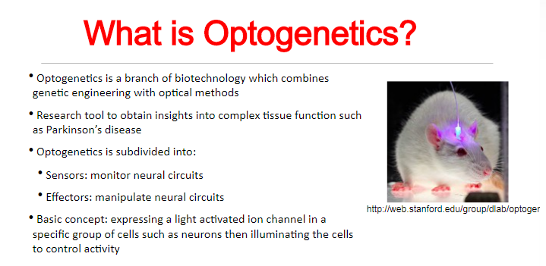

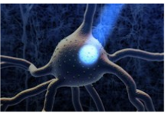
1.1 Introductions of Optogenetics
Notes:
光学技术个基因工程，光刺激开启离子通道，进而导通一系列神经调控生化反应

Slide 4
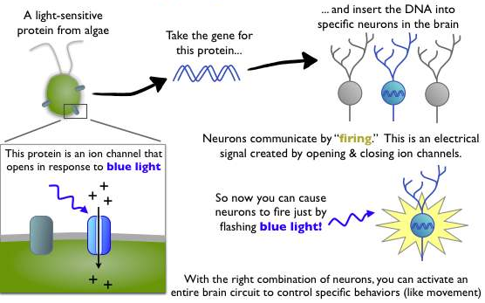
1.2 Methods of Genetic Modification
Notes:
藻类光敏视蛋白，对蓝光响应的蛋白离子通道，
剪辑基因片段敲入大脑神经元中，光刺激，诱发动作电位
实现从光刺激调控神经的效能

Slide 5
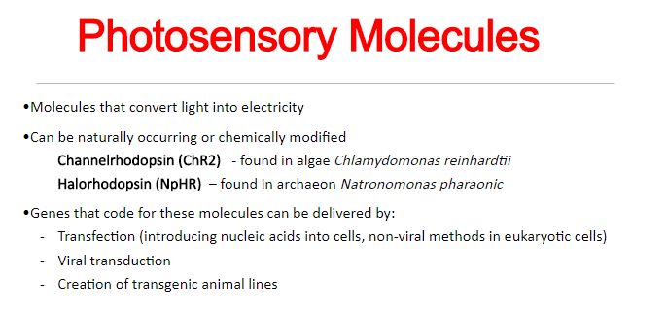
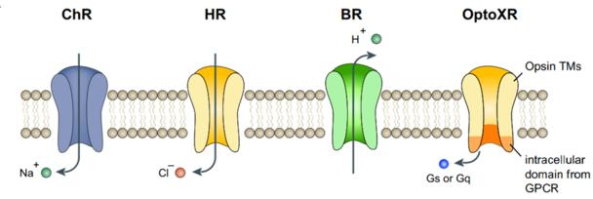
1.3 Photosensory Molecules
光敏感通道蛋白
嗜盐视紫红质
Notes:
ChR2-光敏感通道蛋白，NpHR-嗜盐视紫红质；基因传导方式：转染（真核），病毒传导，转基因

Slide 6
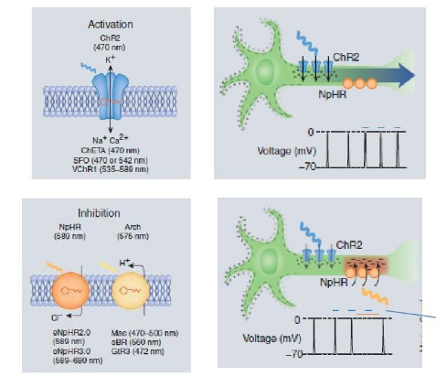
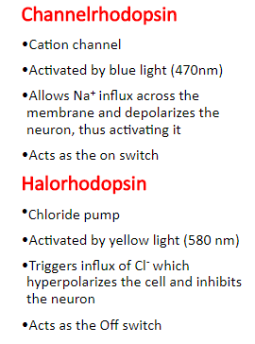
1.4 Controls of Cell Function
Notes:
ChR2-光敏感通道蛋白，正离子通道，Na内流
NpHR-嗜盐视紫红质，。。。
通过施加不同波长的光刺激，即可调控膜蛋白介导的神经信号传导通路

Slide 7
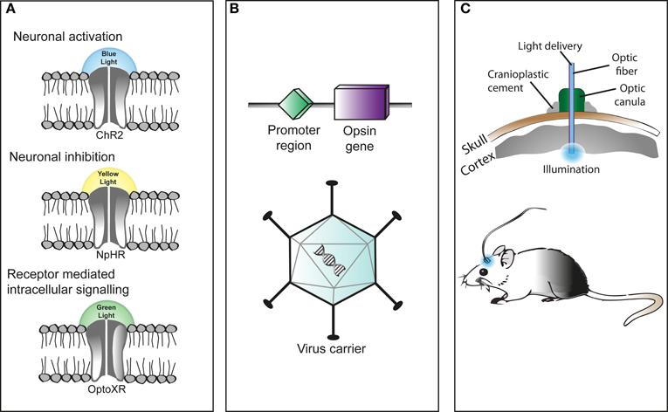
1.5 Mechanism of Stimulation
(A) : light-responsive proteins called opsins，reacts differently to light stimulation of particular wavelengths
(B) express of microbial opsins in mammalian cells : virus injection, transgenic animals, use of Cre-driver animals, Cre-dependent viruses or in utero electroporation
(C) Light can be delivered straight into the brain through an optical fiber, using a chronically implanted cannula that is affixed to the skull.
Notes:
光反应蛋白，视蛋白，特定波长光刺激响应，电学信号
微生物视蛋白在哺乳动物体内表达
光纤电极，光刺激传输受体表面，神经的调控功能

Slide 8
2 Optrode
Design and Fabrication

Slide 9
2.1 Optrode
A light source: activate photosensitive proteins in neurons
Electrical recording sites: simultaneous electrophysiology studies
A rigid or flexible platform: fixation
Data acquisition, transmission and processing

Slide 10
2.2 Challenges
Electrical devices’ chronical performance
Minimize tissue damage and displacement
Small cross-section and overall dimensions
Effective light intensity
Multi-site optrodes- homogeneous distribution of light
Thermal properties
Stimulation artifacts
Compatibility with other technologies
Reliable signal transfer and data acquisition

Slide 11
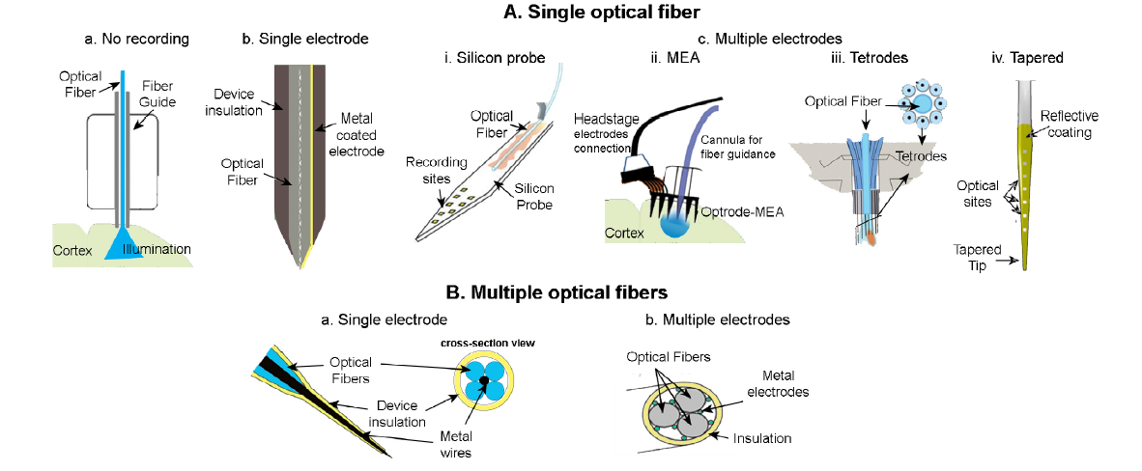
2.3.1 Optical Fiber
State-of-the-art optical fiber optrode designs
Goncalves, S. B., Ribeiro, J. F., Silva, A. F., Costa, R. M., & Correia, J. H. (2017). Design and manufacturing challenges of optogenetic neural interfaces: a review. Journal of Neural Engineering, 14(4), 41001.

Slide 12
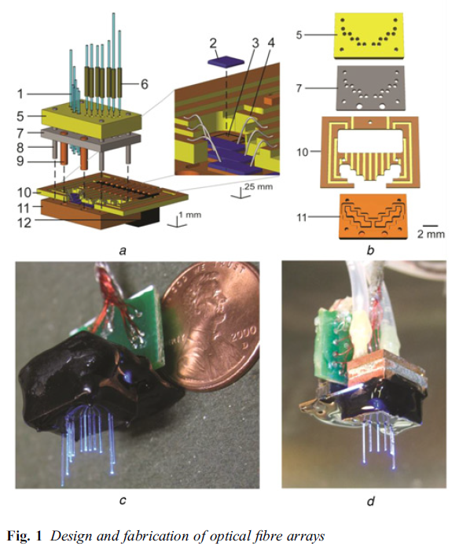
2.3.1 Optical Fiber
1 Optical fibers
2 LED
A 3D fiber array optrode
A stiff silicon housing
A flexible substrate with integrated LEDs
Two sets of special cables
Bernstein, J. G., Allen, B. D., Guerra, A. A., Boyden, E. S. (2015). Processes for design, construction and utilisation of arrays of light-emitting diodes and light-emitting diode-coupled optical fibres for multi-site brain light delivery., 2015(5), 177-184.

Slide 13
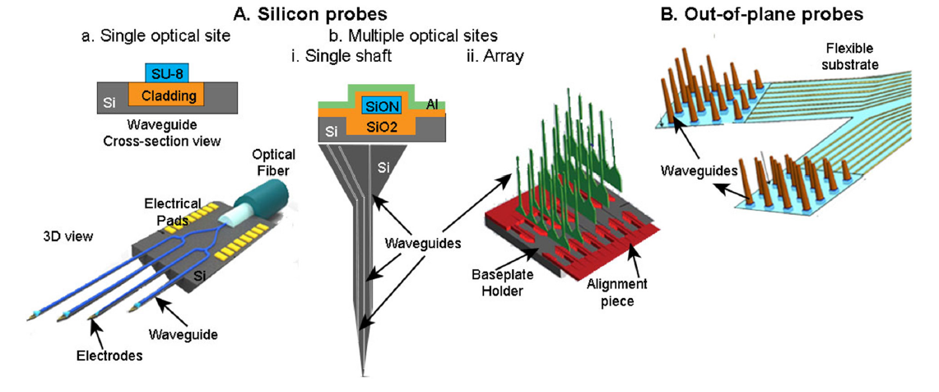
2.3.2 Waveguide
State-of-the-art waveguide optrode designs
Goncalves, S. B., Ribeiro, J. F., Silva, A. F., Costa, R. M., & Correia, J. H. (2017). Design and manufacturing challenges of optogenetic neural interfaces: a review. Journal of Neural Engineering, 14(4), 41001.

Slide 14
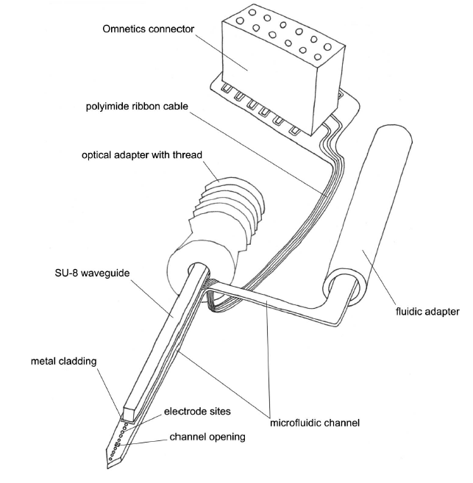
2.3.2 Waveguide
A microfluidic channel
An optical waveguide
Microelectrodes
Rubehn, B., Wolff, S. B. E., Tovote, P., Lüthi, A., & Stieglitz, T. (2013). A polymer-based neural microimplant for optogenetic applications: design and first in vivo study. Lab on a Chip, 13(4), 579-588.

Slide 15
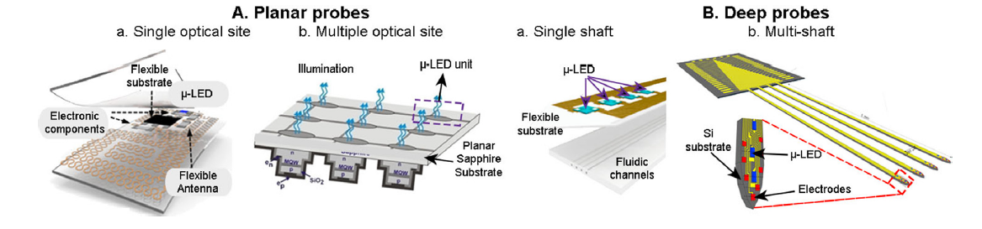
2.3.3 μ-LEDs
State-of-the-art μ-LEDs optrode designs
Goncalves, S. B., Ribeiro, J. F., Silva, A. F., Costa, R. M., & Correia, J. H. (2017). Design and manufacturing challenges of optogenetic neural interfaces: a review. Journal of Neural Engineering, 14(4), 41001.

Slide 16
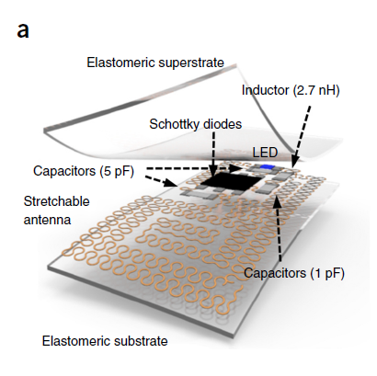
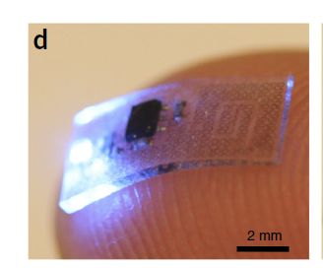
2.3.3 μ-LEDs
Flexible, lightweight
capable of implantation into challenging anatomical shapes
A stretchable RF harvesting unit
Park, S. I., Brenner, D. S., Shin, G., Morgan, C. D., Copits, B. A., Chung, H. U., Rogers, J. A. (2015). Soft, stretchable, fully implantable miniaturized optoelectronic systems for wireless optogenetics. Nature Biotechnology, 33, 1280.

Slide 17
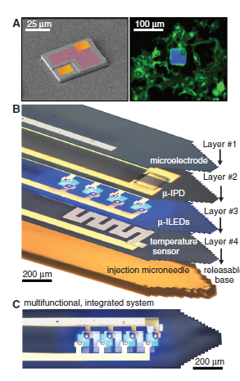
2.4 Multifunctional Integrated System
Releasable injection needles for insertion
Temperature sensors/microheaters: determine the degree of local heating
µ-ILEDs: spatially precise
µ-IPD: measure the intensity of light
Microelectrodes
Kim, T., McCall, J. G., Jung, Y. H., Huang, X., Siuda, E. R., Li, Y., Bruchas, M. R. (2013). Injectable, Cellular-Scale Optoelectronics with Applications for Wireless Optogenetics. Science, 340(6129), 211.

Slide 18
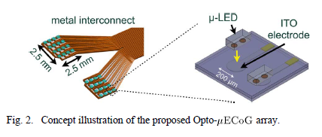
2.4 Multifunctional Integrated System
A Hybrid Neural Interface With Transparent µECoG Electrode Array and Integrated LEDs
K. Y Kwon, B. Sirowatka, A. Weber, W. Li (2013). Opto-μECoG Array: A Hybrid Neural Interface With Transparent μECoG Electrode Array and Integrated LEDs for Optogenetics. IEEE Transactions on Biomedical Circuits and Systems, 7(5), 593-600.

Slide 19
3 Application
optogenetics, NIRS, and NIS
Notes:
optogenetics, near-infrared spectroscopy (NIRS), and direct-near-infrared stimulation (NIS)

Slide 20
3.1 Applications
1、Optogenetics
2、Further Applications of Optical Neural Probes
3、Near-infrared spectroscopy (NIRS)
Functional near-infrared spectroscopy (fNIRS)
A commercial apparatus

Slide 21
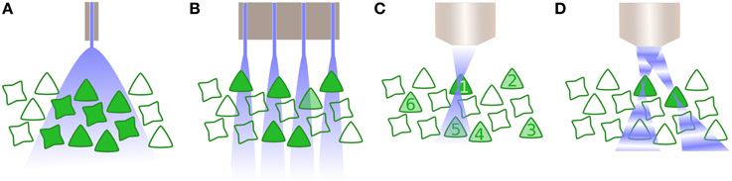
3.2 Optogenetics
Mechanisms underlying coding of cognitive information within the brain
How can a large number of neurons within a population be driven with precise spatial, and defined temporal, resolution？
(a) Whole field illumination
(b) An array of photodiodes
(c) Multiphoton excitation
(d) Digital holography
Figure 3.1 Activating neurons to drive activity (Jarvis & Schultz, 2015)
Notes:
此外，目前还不清楚激活整个细胞群是否足以为大脑提供有用的输入。虽然在一些皮层区域已经证明了种群的放电率编码(Georgopoulos et al.， 1986)，但即使是放电率编码也可能是“标记行”编码，其中细胞身份很重要(Montani et al.， 2007;舒尔茨等人，2009)。一些大脑回路的处理被认为是通过振荡活动中的精确相位延迟来完成的(Engel et al.， 2001)，而大脑中认知信息编码的潜在机制仍然很不清楚。对于后一种方案，即使以类特定的方式对神经元进行全场照明，也显然不会有效。相反，只有一个特定的细胞子集，如定向柱，应该是有针对性的，这是目前不可能使用全场照明。这直接导致了临床光遗传学的最后一个重要技术障碍:如何以精确的空间和时间分辨率驱动种群中的大量神经元?到目前为止，大多数的光发生实验都使用光激子的单光子激发，通常由发光二极管或光纤耦合激光器提供。这种方法的缺点是光发生激活不受空间限制，因此组织区域内所有表达opsin的细胞都会受到影响(图2A)。对于一些光遗传学应用，这可能是不够的。相反，瞄准神经元的亚群是至关重要的，然后就有了替代方案，如使用多位点发光二极管阵列等技术(Grossman et al.， 2010)。然而，这些方法在实践中仅限于视网膜或体外制剂，因为它们几乎不受轴向平面的限制(图2B)。利用光学技术提供精确的时空图形还有两种可能。
第一种是多光子激发(Rickgauer and Tank, 2009)，通常是2光子(2P)，它在空间上受到足够的限制，允许单个细胞的光激活。通过使用两个波长较长的光子之间的相互作用，产生了一个小的点扩展函数(PSF)，它在轴向和横向维度上都受到限制(图2C)，可以在空间中重新定位，从而激活整个组织体积中的单个神经元。然而，由于PSF通常小于soma, 2P激发不足以在不扫描细胞的情况下启动动作电位，从而降低了该技术的时间分辨率(Rickgauer and Tank, 2009)。最近的另一个方法使用波前整形方法,如数字全息术或广义相衬(图2 d),并通过操纵光的相位空间光调制器,光创建一个定义的空间模式同样可以扫描多个神经元体积的组织(Papagiakoumou et al ., 2010;(Oron et al.， 2012)。多光子激发和波前形成都受到限制，其速率与目标神经元的种群大小成正比。此外，尽管在体内和体外都进行了测试，但它们只适用于固定头部的受试者，因此目前阻碍了它在包括自由行为受试者在内的实验中的应用。然而，由于精确的时空模式很可能是必要的，以充分利用光遗传学操纵大脑回路的能力，特别是在涉及突触可塑性机制的地方，这一领域的技术发展是值得密切关注的。

Slide 22
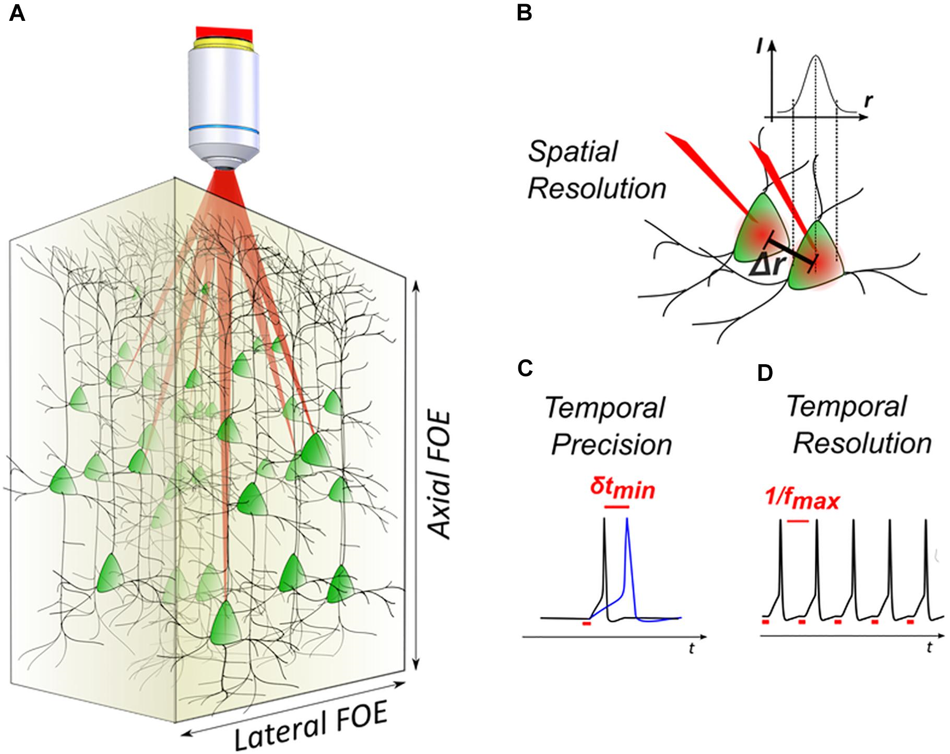
3.3 Optical Neural Probes
3D light-targeted photostimulation
(A) SLM-based multiplexing strategies allow to target opsin-expressing neurons over axial and lateral fields of excitation
(B) The spatial resolution
(C) The temporal precision
(D) The temporal resolution
Figure 3.2 3D light-targeted photostimulation (Ronzitti, Emiliani, & Papagiakoumou, 2018)
Notes:
3 d light-targeted光刺激。
(A)基于slm的多路复用策略可使视蛋白表达神经元在轴向和横向兴奋场上靶向，在大脑中延伸数百微米。
(B)的光刺激分辨率定义了最小距离Δr两个目标,每个目标可以单独激活。
(C)光刺激时间性能与光刺激时间精度,计时精度δt在唤起动作电位(APs)和重复的刺激(即。
(D)时间分辨率，即两个连续的光诱发脉冲之间的最小时间间隔。
，最大光驱神经元放电率fmax)。使用双显微镜设置，通过位于收集物镜焦平面的荧光层扫描产生全息光分布的上物镜(以500 nm的步长)，获得斑点的三维可视化。
记录的堆栈从两个角度进行投影，以更好地说明各个点的点扩展函数。
左侧面板:侧视图;
右侧面板:轴向视图。
使用BioImageXD项目(0.9.0 beta版)进行三维图像重建。
立方体的角落相距20µm。
横向和轴向应用µm 0.3和1.2,分别。
(c)测量横向衍射效率,δ= Ispot /钱数,侧卧位dx的函数生成的点坐标y = 5, z = 0µm和理论曲线(红线),考虑到轴向衍射效率的SLM(方程(3))。
(d)测量轴衍射效率的函数生成的点的轴向位置dz坐标x = 0, y = 5µm和理论曲线(绿线),考虑到轴向SLM的衍射效率。

Slide 23
3.4 NIRS
Functional near-infrared spectroscopy (fNIRS)
The present high temporal resolution multi-channel systems, using the three different NIRS techniques and complex data analysis systems, provide simultaneous multiple measurements and display the results in the form of a map or image over a specific cortical area.
Figure 3.3 Sketch of the development of fNIRS instrumentation (Ferrari & Quaresima, 2012)
Notes:
目前的高时间分辨率多通道系统，使用三种不同的近红外技术和复杂的数据分析系统，同时提供多个测量数据，并以地图或图像的形式显示特定皮层区域的结果。多通道可穿戴和/或无线系统的实现体现了近红外光谱比其他任何神经成像方式都更具有潜力，这些系统甚至可以在日常活动中进行近红外光谱测量。
为了精确而均匀地耦合，波导梳必须靠近底板支架的垂直位置，并且必须以较高的精度横向间隔

Slide 24
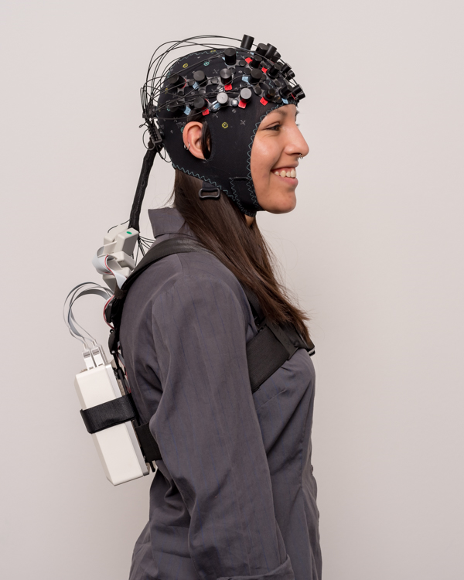
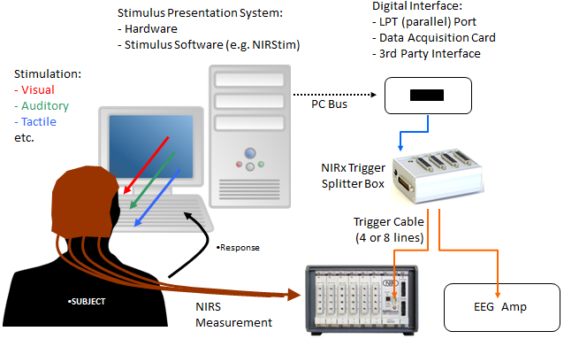
3.4 NIRS
A commercial apparatus
(a) Example of NIRSport 2 + EEG Data Integration
(b) NIRSport 2 with back strap for mobile applications
Figure 3.4 An Example of commercial NIRS measurement
https://nirx.net/nirsport
Notes:
与NIRSport 2和EEG系统的数据集成在事件同步方面非常简单。
这可以在实验开始和结束时，在“触发”事件期间，或者在实验期间任意执行。
右例:表示计算机生成的事件触发器被发送到数字接口(触发器分配器)，然后事件被发送到NIRx触发器分配器盒，分割每个触发器并保持适当的电压，将偶数信号发送到近红外(NIRS)和脑电图(EEG)系统。
这种触发分割方法可以从不同的输入设备(如TMS、眼球跟踪等)中使用，并发送到多个记录设备。
该系统重量只有~800g。
保持放大器在后面，而不是安装在头帽，让头部和颈部自由地以自然的方式移动。

Slide 25
4 Vision of the Future
limitations &Possibilities of optogenetic

Slide 26
4.1 Clinical Application
1. Parkinson's disease
The loss of LC-NE is the basis of the early cognitive dysfunction of Parkinson's disease, which can be targeted and controlled by optogenetic technology.
Vazey E M , . Frontiers in Behavioral Neuroscience, 2012, 6.
Notes:
LC-NE的丢失特别是更高的大脑皮质的LC-NE的丢失是构成帕金森病早期认知功能障碍的基础，能够通过光遗传学技术靶向控制LC-NE。

Slide 27
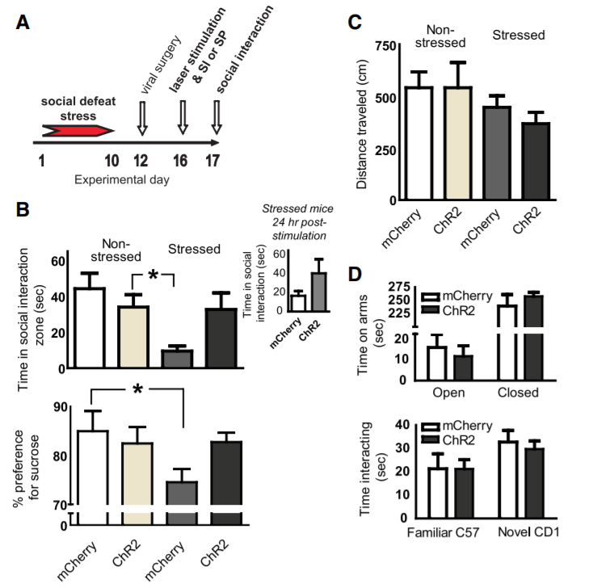
4.1 Clinical Application
2. Depression
Light stimulation of the medial prefrontal cortex (MPFC) can reduce depressive behavior, but optogenetics can target specific cell subsets, making it possible to further study the substrates and treatment strategies for many diseases, including depression.
Covington H E , . Journal of Neuroscience, 2010, 30(48):16082-16090.
Carter M E , Yizhar O , Chikahisa S , et al.
Nature Neuroscience, 2010, 13(12):1526-1533.
Notes:
目前药物治疗无法完全控制，内侧前额叶皮质常被认为与已与有关，光刺激MPFC能够减轻抑郁行为但是光遗传学能够靶向控制特定的细胞亚群，从而使进一步研究抑郁症在内的多种疾病的基质及治疗策略成为可能

Slide 28
4.1 Clinical Application
3. Retinal degeneration disease
In retinal degenerative diseases, optogenetics can restore the vision of patients to some extent by injecting opsin gene and activating opsin by external light.
Thyagarajan S , et al. Journal of Neuroscience, 2010, 30(26):8745-8758.
Notes:
在视网膜色素变性、老年性黄斑变性等视网膜变性性疾病中,应用光遗传学技术玻璃体腔或视网膜下注射视蛋白基因,由外界给予相应的光照激活视蛋白,模拟并代替视网膜光感受器功能,可在一定程度上恢复患者视力.

Slide 29
4.3 Limitations
1. Risks of Virus transfectionand ;
2. Selection of target cells ;
3. Immunogenicity.
Notes:
病毒转染有潜在风险：是否会引起脑细胞死亡或脑组织损伤还是未知的。
细胞靶向性：难以准确选择目标靶点细胞。
免疫原型：载体病毒是否会引发免疫反应还是未知数。

Slide 30
4.3 Possibilities
1. Noninvasive light stimulation ;
2. Miniaturization and portability;
3. Biomaterial ;
4. More clinical areas: blood sugar, cardiac function, muscle.
Notes:
1.无创
2.微型化及无创化
3.材料的选择（生物相容性）

Slide 31
THANK YOU！
Q&A

Slide 32
References-Theory
Boyden, E.S., Zhang, F., Bamberg, E., Nagel, G., Deisseroth, K., 2005. Millisecond-timescale, genetically targeted optical control of neural activity. Nat. Neurosci. 8, 1263–1268.
Lee, J.H., et al., 2010. Global and local fMRI signals driven by neurons defined optogenetically by type and wiring. Nature 465, 788–792.
Mattis, J., et al., 2011. Principles for applying optogenetic tools derived from direct comparative analysis of microbial opsins. Nat. Methods 9, 159–172.
Nagel, G., et al., 2002. Channelrhodopsin-1: a light-gated proton channel in green algae. Science 296, 2395–2398.
Rogan, S.C., Roth, B.L., 2011. Remote control of neuronal signaling. Pharmacol. Rev. 63, 291–315.
Tye, K.M., Deisseroth, K., 2012. Optogenetic investigation of neural circuits underlying brain disease in animal models.Nat. Rev. Neurosci. 13, 251–266.
Yizhar, O., et al., 2011. Neocortical excitation-inhibition balance in information processing and social dysfunction. Nature 477, 171–178.
Zhang, F., et al., 2011. The microbial opsin family of optogenetic tools. Cell 147, 1446–145

Slide 33
References-Optrode
Goncalves, S. B., Ribeiro, J. F., Silva, A. F., Costa, R. M., & Correia, J. H. (2017). Design and manufacturing challenges of optogenetic neural interfaces: a review. Journal of Neural Engineering, 14(4), 41001.
Bernstein, J. G., Allen, B. D., Guerra, A. A., Boyden, E. S. (2015). Processes for design, construction and utilisation of arrays of light-emitting diodes and light-emitting diode-coupled optical fibres for multi-site brain light delivery., 2015(5), 177-184.
Rubehn, B., Wolff, S. B. E., Tovote, P., Lüthi, A., & Stieglitz, T. (2013). A polymer-based neural microimplant for optogenetic applications: design and first in vivo study. Lab on a Chip, 13(4), 579-588.
Park, S. I., Brenner, D. S., Shin, G., Morgan, C. D., Copits, B. A., Chung, H. U., Rogers, J. A. (2015). Soft, stretchable, fully implantable miniaturized optoelectronic systems for wireless optogenetics. Nature Biotechnology, 33, 1280.
Kim, T., McCall, J. G., Jung, Y. H., Huang, X., Siuda, E. R., Li, Y., Bruchas, M. R. (2013). Injectable, Cellular-Scale Optoelectronics with Applications for Wireless Optogenetics. Science, 340(6129), 211.
Kwon K. Y., Sirowatka B., Weber A., Li W. (2013). Opto-μECoG Array: A Hybrid Neural Interface With Transparent μECoG Electrode Array and Integrated LEDs for Optogenetics. IEEE Transactions on Biomedical Circuits and Systems, 7(5), 593-600.

Slide 34
References-Application
Alt, M. T., Fiedler, E., Rudmann, L., Ordonez, J. S., Ruther, P., & Stieglitz, T. (2017). Let There Be Light—Optoprobes for Neural Implants. Proceedings of the IEEE, 105(1), 101-138. doi:10.1109/JPROC.2016.2577518
Kim, H. K., Alexander, A. L., & Soltesz, I. (2018). Optogenetics: Lighting a Path from the Laboratory to the Clinic. In A. Stroh (Ed.), Optogenetics: A Roadmap (pp. 277-300). New York, NY: Springer New York.
Yazdan-Shahmorad, A., Diaz-Botia, C., Hanson, T. L., Kharazia, V., Ledochowitsch, P., Maharbiz, M. M., & Sabes, P. N. (2016). A Large-Scale Interface for Optogenetic Stimulation and Recording in Nonhuman Primates. Neuron, 89(5), 927-939. doi:10.1016/j.neuron.2016.01.013
Jarvis, S., & Schultz, S. R. (2015). Prospects for Optogenetic Augmentation of Brain Function. Front Syst Neurosci, 9, 157. doi:10.3389/fnsys.2015.00157
Ferrari, M., & Quaresima, V. (2012). A brief review on the history of human functional near-infrared spectroscopy (fNIRS) development and fields of application. Neuroimage, 63(2), 921-935. doi:10.1016/j.neuroimage.2012.03.049
Ronzitti, E., Emiliani, V., & Papagiakoumou, E. (2018). Methods for Three-Dimensional All-Optical Manipulation of Neural Circuits. Frontiers in Cellular Neuroscience, 12(469). doi:10.3389/fncel.2018.00469

Slide 35
References-Vision of the Future
Vazey E M , Gary A J . The emerging role of norepinephrine in cognitive dysfunctions of Parkinson's disease[J]. Frontiers in Behavioral Neuroscience, 2012, 6.
Carter M E , Yizhar O , Chikahisa S , et al. Tuning arousal with optogenetic modulation of locus coeruleus neurons[J]. Nature Neuroscience, 2010, 13(12):1526-1533.
Covington H E , Lobo M K , Maze I , et al. Antidepressant Effect of Optogenetic Stimulation of the Medial Prefrontal Cortex[J]. Journal of Neuroscience, 2010, 30(48):16082-16090.
Thyagarajan S , Van Wyk M , Lehmann K , et al. Visual Function in Mice with Photoreceptor Degeneration and Transgenic Expression of Channelrhodopsin 2 in Ganglion Cells[J]. Journal of Neuroscience, 2010, 30(26):8745-8758.
Willett K , Maguire A , Sahel J , et al. Safety and Efficacy of Retinal Optogenetic Therapy in Canine Models[J]. Invest Ophthalmol Vis Sci, 2013.
Kale R P , Kouzani A Z , Walder K , et al. Evolution of optogenetic microdevices[J]. Neurophotonics, 2015, 2(3):031206.

